Slide 1
Iot group project
BY: Gurpreet, khushveen, kiranJIT, Anderson
Group name: overnight_coders
Product: locker-clock (alarm clock)

Slide 2
Project description
Set current and alarm time.
To turn off use rotation sensor.

Slide 3
Tools Used
Trello
Fritzing
Pencil
Draw.io
Visual studio code
Arduino ide
Gitlab

Slide 4
Main sources used
We used (https://create.arduino.cc/projecthub) website to get some ideas about our project.
We used some class activities to understand the functionality of each sensor and also how to modify the sensor’s coding to our requirement.
Our team share ideas with each other to get the functionality of our project done , we change few things everytime to modify and reach our goal of alarm clock.
Mr. Klinger Silva also gave us some important tips when we are stuck at some point of time in our project which was very helpful in reaching our milestone.

Slide 5
What went well
We were able to work very well as a team.
Open to suggestions.
Time management.
Tool usage.
Communication.

Slide 6
Potential Improvements
Real Time Clock (RTC) – Keep track of current time even when Arduino is off.
Add more external buttons to extra functions.
Improve accuracy in setting the clock and alarm times.
Allow user to select different tones.
Let the user decides the time until a “combination” is read by the device.
LCD Standby Mode to save power.

Slide 7
challengeS
Be realistic: Extra features means extra work. Making decisions about what to do.
Prototyping: Using the light sensor prioritized part of the development.
Planning-Coding-Testing cycle: Fix part of the code and break the rest (or not).
Avoid anxiety to code: See where you want to go before starting the journey.
Break big problems: Make them smaller so it’s easier to solve them.

Slide 8
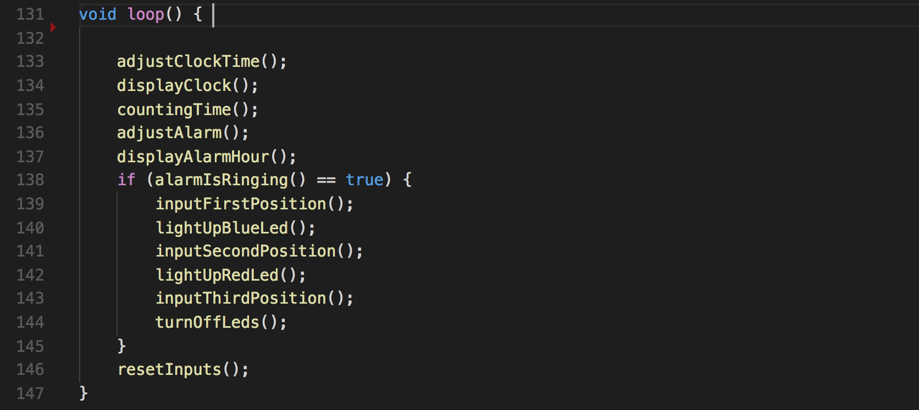
BREAKING BIG PROBLEMS:

Slide 9
Video Demonstration

Slide 10
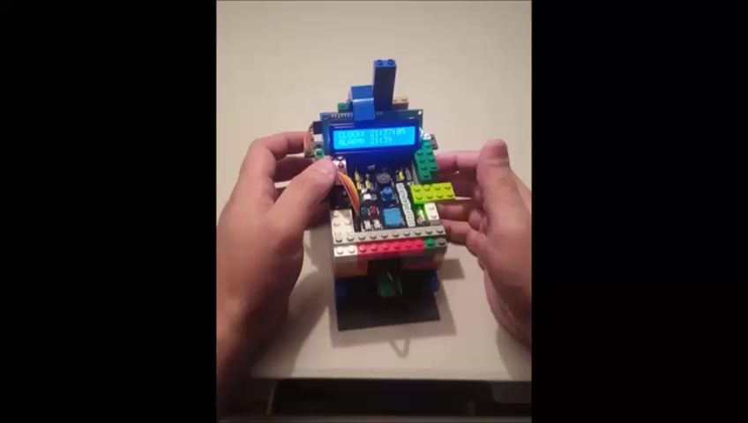

Slide 11
LIVE DEMONSTRATION

Slide 12
QUESTIONS?

Slide 13
Thank you for your time!
overnight_coders

